Slide 1
The Monumental

Slide 2
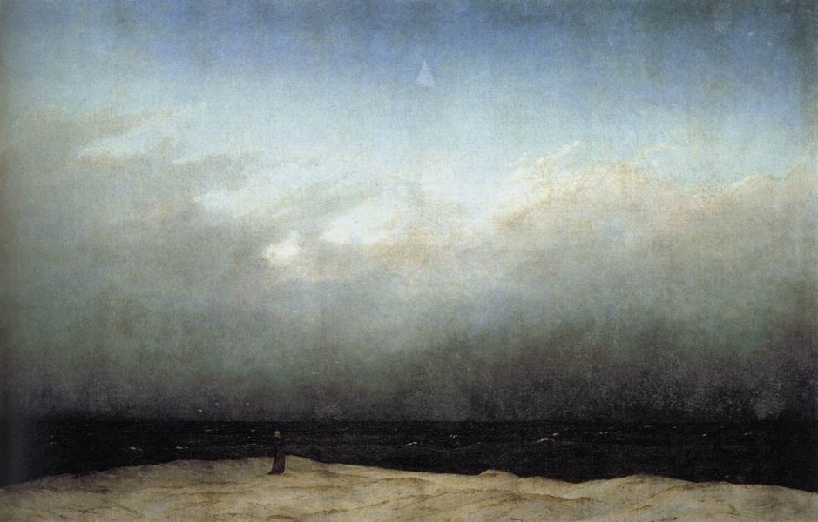

Notes:
Now, I'm titling this section "Monumental" but I don't want you to think this is a movement or anything. I'm mostly interested in exploring how monumental scale, really big artworks, came about in the 60's and 70's. Scale isn't entirely new, we talked about big scale with the Abstract Expressionists, and certainly big artworks existed in the past, sometimes assembled by large teams of artists like Michelangelo's Sistine Chapel, or even Stonehenge.
Here we have a painting by the German Romanticist Caspar David Friedrich. I want to show this to you because the painting isn't even all that big compared to the art we have seen so far, less than four feet across. But by painting the tiny figure of the monk staring out at the vast sea, he creates in our mind an understanding of scale, of the immenseness of nature that could swallow us whole.
This feeling of being a tiny speck in the vast universe, both the terror and awe of this feeling, is referred to as the sublime.

Slide 3
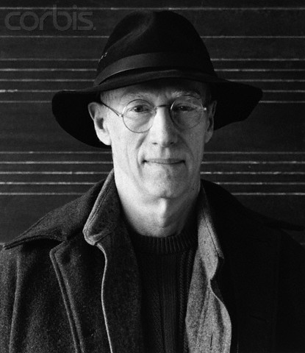
Robert Morris
Notes:
The work of Robert Morris doesn't fit neatly into just one category. He is often though of as a minimalist, but his ideas and Donald Judd's were diametrically apposed.

Slide 4
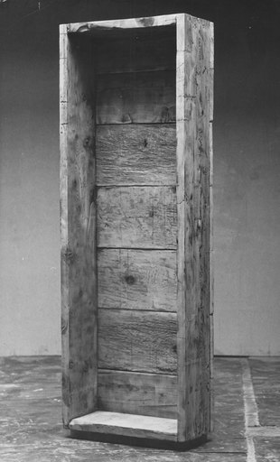
Notes:
Now looking at this piece that looks like a rough wooden crate, you probably understand if I call it minimalist. Its a very simple box like a lot of what we see from the minimalists. And you can see that it's very different than a Judd, in that it's rough instead of smooth, it looks old and well worn rather than new and shiny. But would you believe me if I said you could think of it as figurative abstraction?

Slide 5
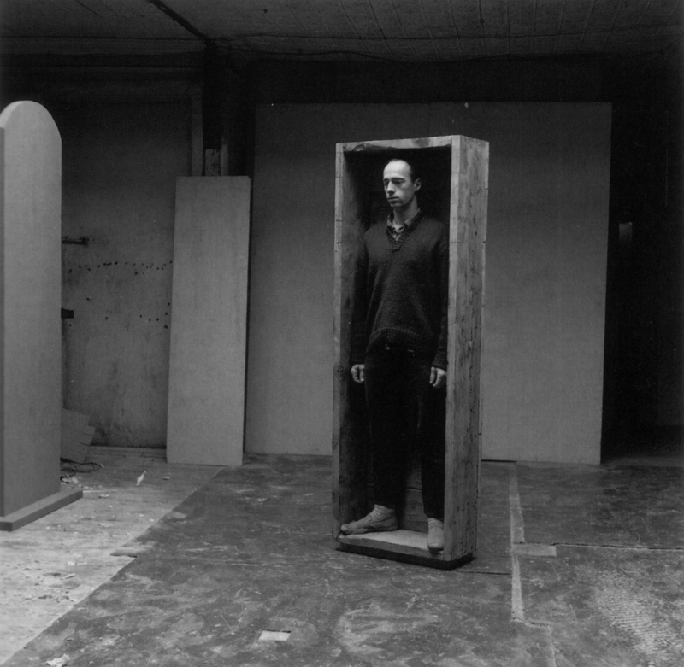
Notes:
Morris titled this piece "Box For Standing", and here's a picture of him in his studio doing just that, standing in his sculpture. So the box references the human figure, his human figure to be exact, since it's made to fit his height and width.

Slide 6
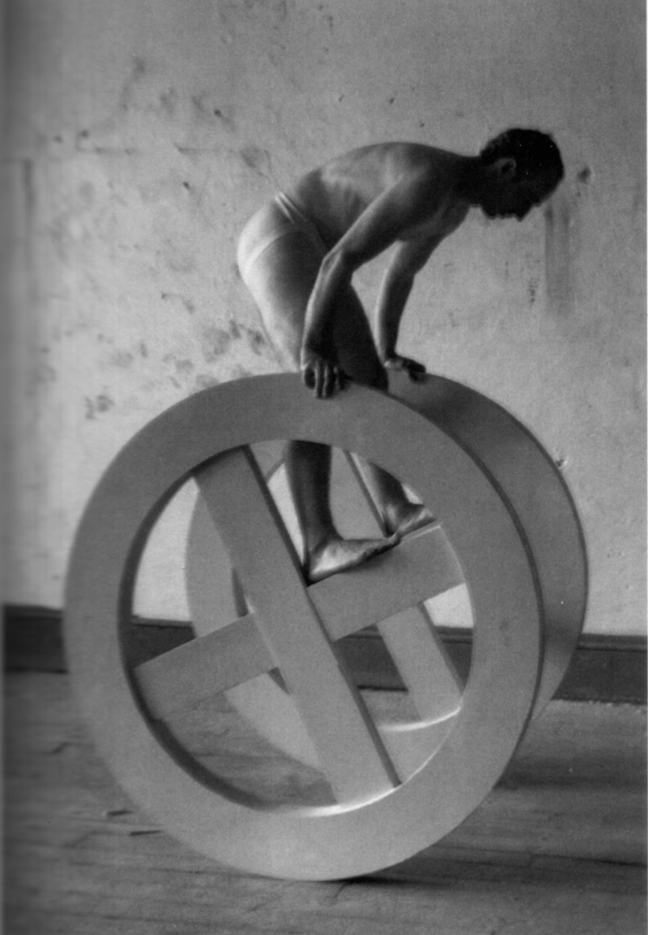
Notes:
In fact, a lot of Morris' pieces reference the human figure in some way, like this piece called wheels, which was made in a dimension that allowed Morris to wheel around, turning the sculpture into a performance piece. Donald Judd didn't like this at all; it didn't fit what he thought the new three dimensional work should be, in fact he felt it wasn't even sculpture, it was a theatre prop.

Slide 7
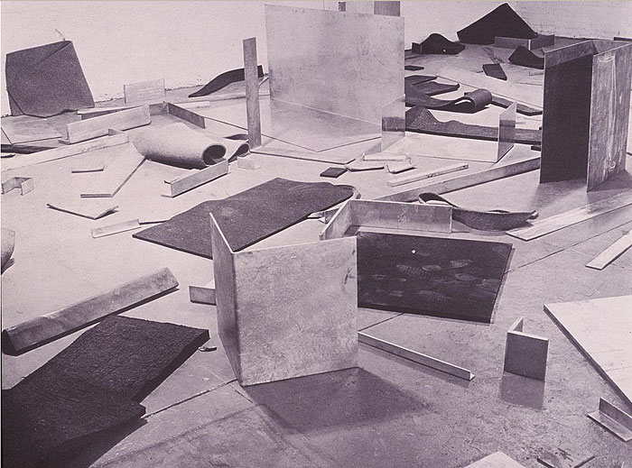
Notes:
I bring Morris up with the idea of the monumental because he also made pieces he called "Scatter Pieces" that I think of as landscapes. He would fill the gallery space with industrial materials from wall to wall, making more of an environment to be walked through, rather than a single piece that you could take in from one vantage point.

Slide 8
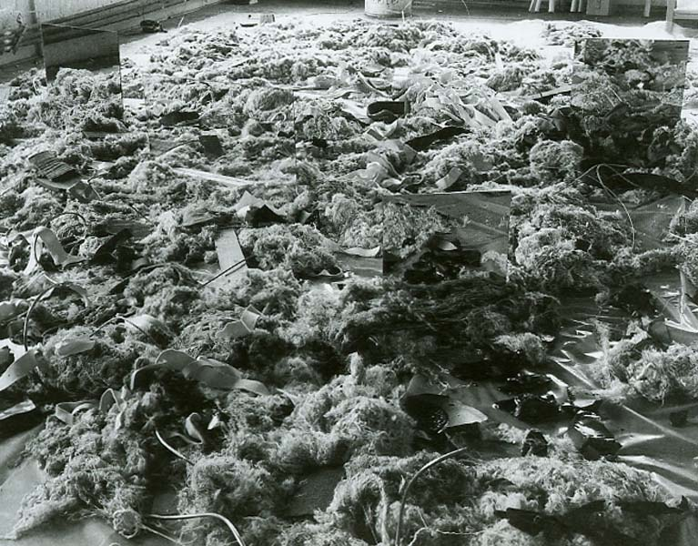
Notes:
Notice the mirrors he used in this one, reflecting the softer materials back at themselves. The mirrors almost act as gateways, allowing the space to be even bigger than the size of the room.

Slide 9
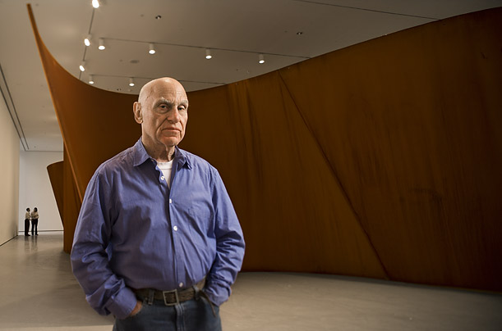
Richard Serra
Notes:
Richard Serra is another artists interested in monumental scale, as you can see from the enormous piece behind him.

Slide 10
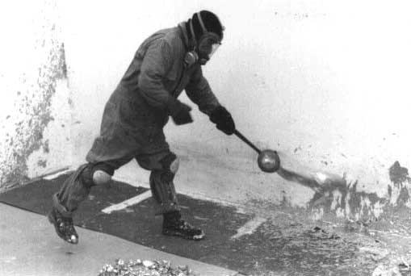
Notes:
He also had some roots in performance, as you can see from this photograph of his creating one of his pieces call "Throwing Lead". I hope you can see the relationship to Jackson Pollock splashing paint on the horizontal canvas. Serra takes from the macho gestures of the Abstract Expressionists and ups the ante, throwing liquid lead directly onto the walls and floor.

Slide 11
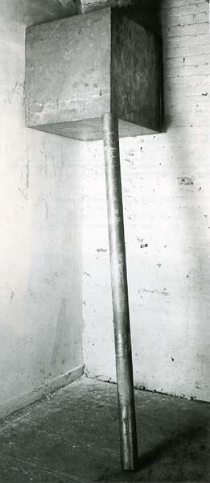
Notes:
Sometimes, like Morris' box for standing, the performance is implied. Serra made many prop pieces, which included a feeling of danger through potential energy. Here a steel cube in propped into the corner of the room and held in place with a thick rod. The piece looks like a human sized trap, just waiting to crush someone to death.

Slide 12
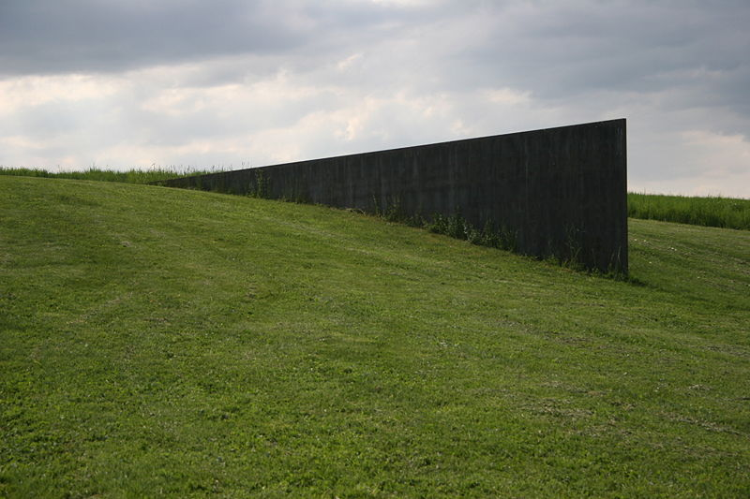
Notes:
Like the earth artists we will study next, sometimes his work was installed outside, such as this steel plate wedged directly into the earth.

Slide 13
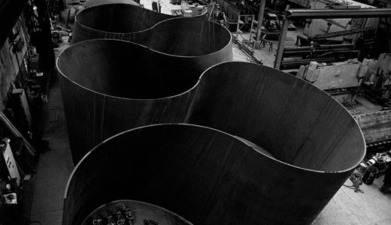
Notes:
Serra, continues to work with heavy steel sheets in gigantic proportions. He builds small models of the pieces which are then reproduced by a team of construction workers. These pieces are so massive they must be assembled in shipyards.

Slide 14
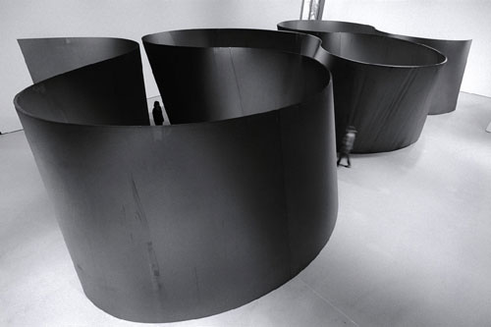
Notes:
They tower over the viewers as they walk in and out of them.

Slide 15
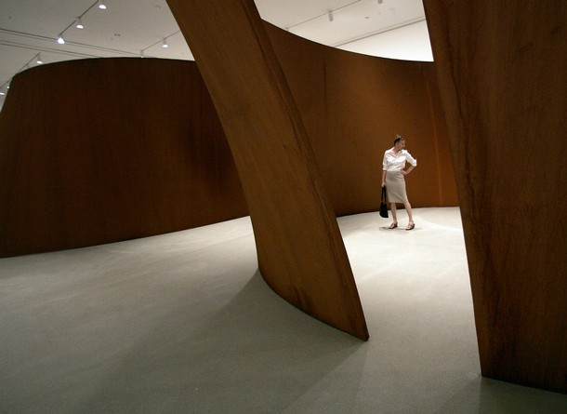
Notes:
The steel is left outside for a long time to develop a warm rusty patina.

Slide 16
Images:
Caspar David Friedrich
Monk by the Sea, 1809
Robert Morris
Box For Standing, 1961
Wheels, 1963
Untitled (felt), 1968
Scatter Pieces, 1968, 1969
Richard Serra
Throwing Lead, 1968
Corner prop, 1969
Schunnemunk Fork, 1990-91
Band, 2006
Notes:
Caspar David Friedrich
Monk by the Sea, 1809
Robert Morris
Box For Standing, 1961
Wheels, 1963
Untitled (felt), 1968
Scatter Pieces, 1968, 1969
Richard Serra
Throwing Lead, 1968
Corner prop, 1969
Schunnemunk Fork, 1990-91
Band, 2006

